Slide 1
Hash-Based Indexes
Notes:
1
The slides for this text are organized into chapters. This lecture covers Chapter 11, and discusses hash-based indexing in depth.
It should be covered after Chapter 8, which provides an overview of storage and indexing. At the instructor’s discretion, it can also be omitted without loss of continuity in other parts of the text. (In particular, Chapter 20 can be covered without covering this chapter, though covering this chapter will certainly provide a stronger foundation.)

Slide 2
Introduction
Hash-based indexes are best for equality selections. Cannot support range searches.
A good hash function is:
  Random
  Uniform
Static and dynamic hashing techniques exist; trade-offs similar to ISAM vs. B+ trees.
Notes:
2

Slide 3
What is Hashing
In DBMS, hashing is a technique to directly search the location of desired data on the disk without using index structure.
Hashing method is used to index and retrieve items in a database as it is faster to search that specific item using the shorter hashed key instead of using its original value.
Data is stored in the form of data blocks whose address is generated by applying a hash function in the memory location where these records are stored known as a data block or data bucket.

Slide 4
Why do we need Hashing
For a huge database structure, it’s tough to search all the index values through all its level and then you need to reach the destination data block to get the desired data.
Hashing method is used to index and retrieve items in a database as it is faster to search that specific item using the shorter hashed key instead of using its original value.
Hashing is an ideal method to calculate the direct location of a data record on the disk without using index structure.
It is also a helpful technique for implementing dictionaries.

Slide 5
Important Terminology in Hashing
Data bucket – Data buckets are memory locations where the records are stored. It is also known as Unit Of Storage.
Key: A DBMS key is an attribute or set of an attribute which helps us to identify a row(tuple) in a relation(table). This allows us to find the relationship between two tables.
Hash function: A hash function, is a mapping function which maps all the set of search keys to the address where actual records are placed.
Linear Probing – Linear probing is a fixed interval between probes. In this method, the next available data block is used to enter the new record, instead of overwriting on the older record.

Slide 6
Continue..
Quadratic probing– It helps us to determine the new bucket address. It helps us to add Interval between probes by adding the consecutive output of quadratic polynomial to starting value given by the original computation.
Hash index – It is an address of the data block. A hash function could be a simple mathematical function to even a complex mathematical function.
Double Hashing –Double hashing is a computer programming method used in hash tables to resolve the issues of has a collision.
Bucket Overflow: The condition of bucket-overflow is called collision. This is a fatal stage for any static has to function.

Slide 7
Types of Hashing
There are mainly two types of SQL hashing methods/techniques:
Static Hashing
Dynamic Hashing
Static Hashing
In the static hashing, the resultant data bucket address will always remain the same.
Therefore, if you generate an address for say Student_ID = 10 using hashing function mod(3), the resultant bucket address will always be 1. So, we will not see any change in the bucket address.

Slide 8
Types of Static Hashing
Static hashing is further divided into
Open hashing
Close hashing.
Open Hashing
In Open hashing method, Instead of overwriting older one the next available data block is used to enter the new record, This method is also known as linear probing.
For example, X1 is a new record which we wants to insert. The hash function generates address as 222. But it is already occupied by some other value. That’s why the system looks for the next data bucket 301 and assigns X1 to it.
Close Hashing
In the close hashing method, when buckets are full, a new bucket is allocated for the same hash and result are linked after the previous one.

Slide 9
Dynamic Hashing
Dynamic hashing offers a mechanism in which data buckets are added and removed dynamically and on demand. In this hashing, the hash function helps us to create a large number of values.
Notes:
9

Slide 10
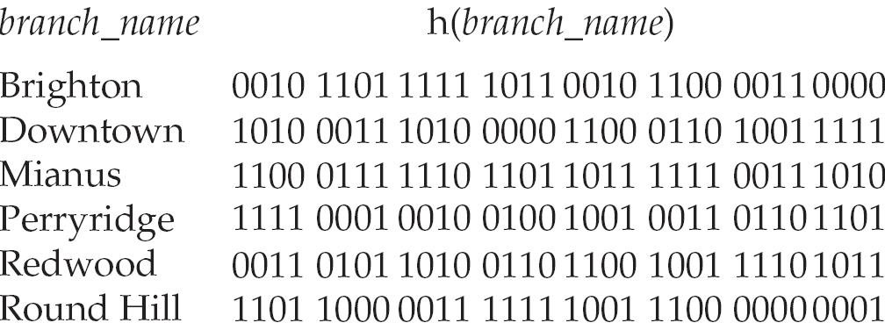
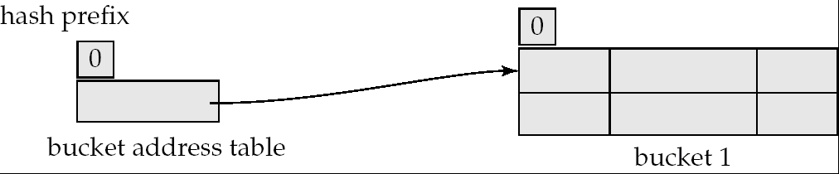
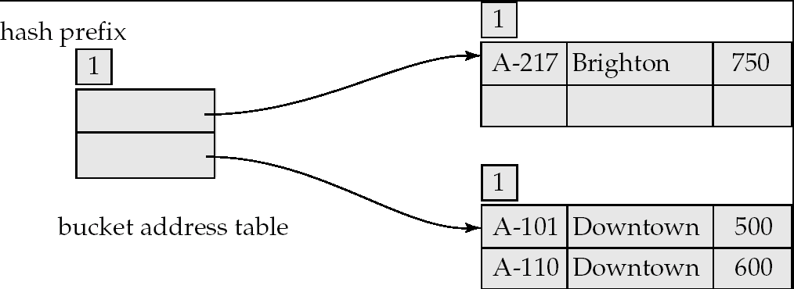
Example of Dynamic Hashing
Insert
Brighton
Downtown
Downtown
Mianus
Perryridge
Perryridge
Perryridge
Round Hill

Slide 11
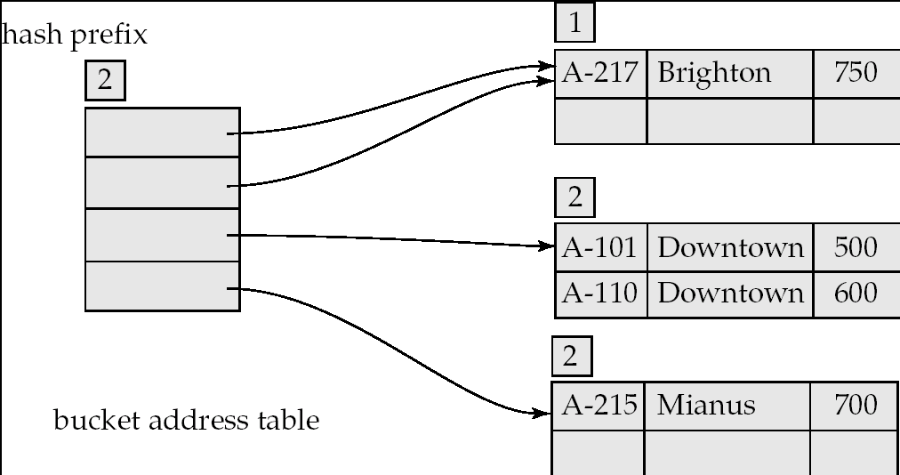
Example of Dynamic Hashing

Slide 12
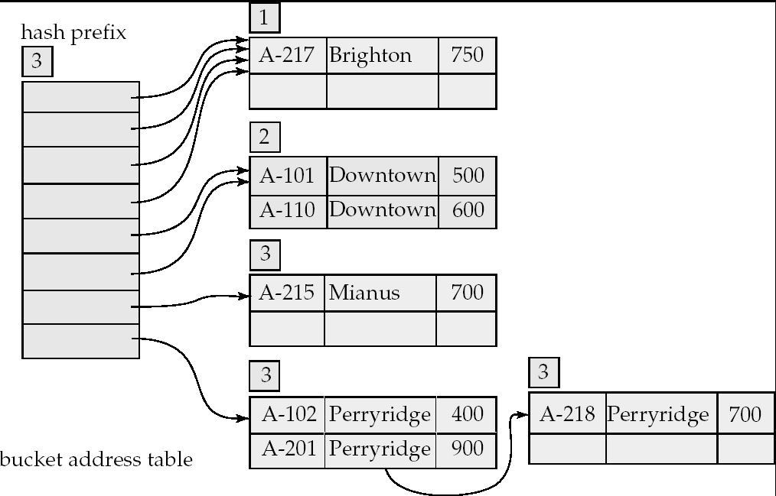
Example of Dynamic Hashing

Slide 13
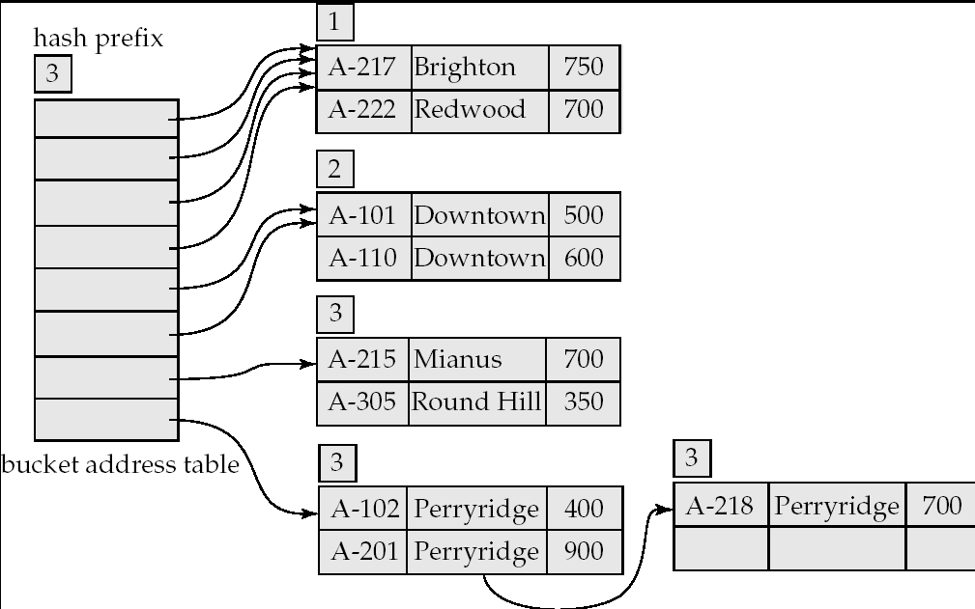
Example of Dynamic Hashing

Slide 14
Linear Probing
In linear probing,
When collision occurs, we linearly probe for the next bucket.
We keep probing until an empty bucket is found.
Advantage-
It is easy to compute.
Disadvantage-
The main problem with linear probing is clustering.
Many consecutive elements form groups.
Then, it takes time to search an element or to find an empty bucket.
Notes:
10

Slide 15
Linear Probing
Time Complexity-
Worst time to search an element in linear probing is O (table size).
This is because-
Even if there is only one element present and all other elements are deleted.
Then, “deleted” markers present in the hash table makes search the entire table.
Notes:
10

Slide 16
Problem-
Using the hash function ‘key mod 7’, insert the following sequence of keys in the hash table-
50, 700, 76, 85, 92, 73 and 101
Use linear probing technique for collision resolution.
Notes:
17

Slide 17
Quadratic Probing-
In quadratic probing,
When collision occurs, we probe for i²‘th bucket in i^{th} iteration.
We keep probing until an empty bucket is found.
Double Hashing-
In double hashing,
We use another hash function hash2(x) and look for i * hash2(x) bucket in i^{th} iteration.
It requires more computation time as two hash functions need to be computed.
Notes:
17

Slide 18
Thank You

